Slide 1
Apple Quality Dataset
ISYE 630 Advanced Quality Control
Group Project
Abdullah Omer Mohammed, Fouzan Abdullah, Mohammed Mustafa, Sai Satya Saketh Nella

Slide 2
Introduction of the Dataset
Apple Quality Dataset downloaded from Kaggle
6 Quality characteristics measured as continuous variables, 1 quality characteristic as binary (good or bad)
Values indicate an index with an approximate range of -7.5 to 7.5 for continuous variables
The binary column encoded as 1 for good and 0 for bad for analysis

Slide 3
Original Dataset: Data Description

Slide 4
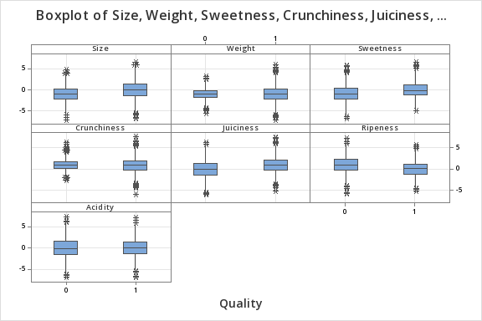
Original Dataset: Box Plots

Slide 5
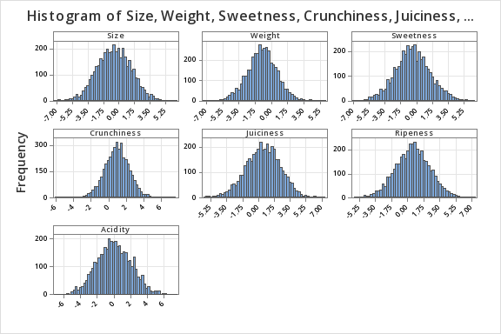
Original Dataset: Histograms
As can be seen, all the fields form a roughly normal distribution.
A few outliers can be seen, more evident in the box plots than here
Notice the tightly packed Crunchiness field

Slide 6
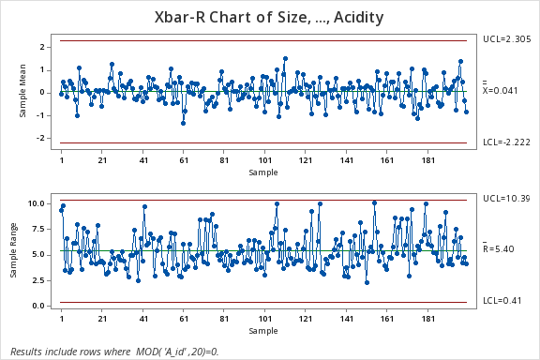
Original Data: Xbar-R Chart
Chart made for subgroup size 20 (every 20th row).
All continuous variables plotted combined
Seemingly in control
Xbar limits are too big compared to the data points
R Chart’s lower limit is too low compared to the data points

Slide 7
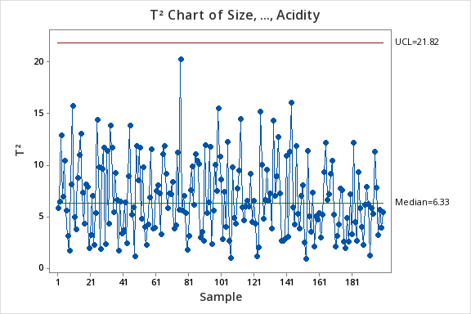
Original Data: Hotelling Chart (T2)
Tested this out since all the variables define a single binary variable; good or bad apple
In control, although the UCL is too great
Plotted for subgroup size of 20

Slide 8
Original Data: Correlation (PearsonR)
To find out link between any of the continuous variables with the apple quality, we did the correlation test
We are interested in only what effect each variable has on the quality
Size, Sweetness and Juiciness showed a weak positive correlation with quality
Ripeness showed a weak negative correlation with quality
These variables will be investigated further for quality analysis

Slide 9
Data Cleaning
Made a frequency table with bins array ranging from -7.5 to 7.5 with increment of 1
Identified the 80% (count of 3200) values were included in the bin range -1.5 to 2.5 for all the variables (rough estimate of 80% for each)
Filtered data out by filtering on crunchiness, which had the highest count for values falling within that bin range (3429 rows)
Made the xbar-R and T2 chart for the cleaned data

Slide 10
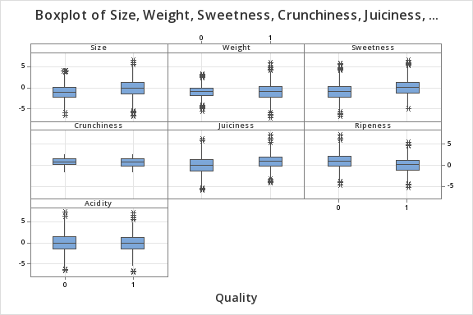
Cleaned Data: Box Plots
Since we filtered on Crunchiness, the outliers are most removed from that box plot.
The other variables still show a lot of variables because there are still a lot of data points

Slide 11
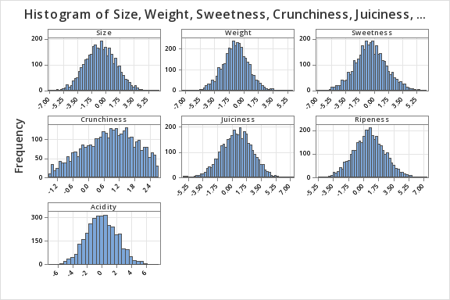
Cleaned Data: Histograms
At first look, there is not a noticeable difference among the histograms of all variables
However, crunchiness has a lot less data points now, evident from the y-axis scale.

Slide 12
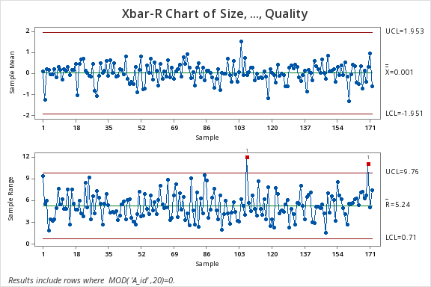
Cleaned Data: Xbar-R Chart
The limits for Xbar chart, although slightly smaller, are still too big for the data points
R chart is out of control at two points, but it is a much better fit in the limits now
Plotted for subgroup size of 20 (every 20th row)

Slide 13
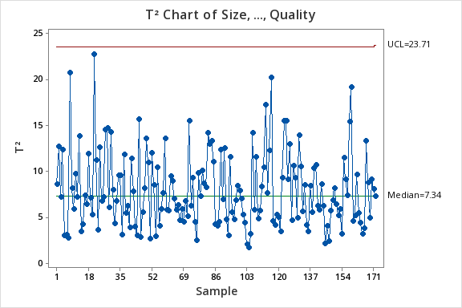
Cleaned Data: Hotelling Chart (T2)
In control, doesn’t show much of a difference with the original data
Median is a little bit higher
UCL is still way too big for the data points
Plotted for subgroup size 20

Slide 14
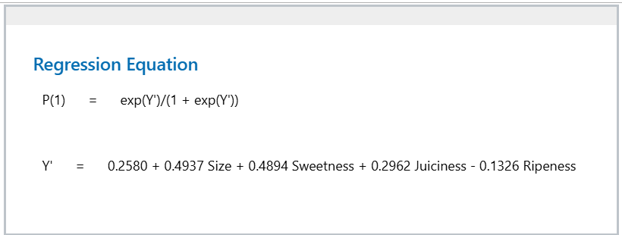
Correlated Variables: Factors affecting Quality
We identified the variables Size, Sweetness, Juiciness as having a positive correlation with quality
Ripeness had a negative correlation with quantity
To identify the extent of these variables contribution to quality, we did a binary logistic regression (result shown below)

Slide 15
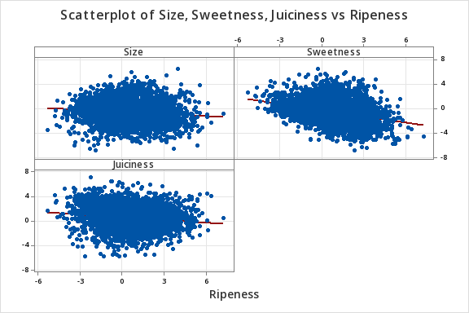
Correlated Variables: Scatter Plot
Slight negative trend in Sweetness and Juiciness with Ripeness
Mostly uniform trend in Size vs Ripeness

Slide 16
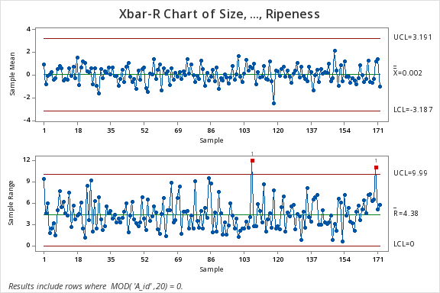
Correlated Variables: Xbar-R Chart
Plotted for subgroup size 20 (every 20th row)
Xbar chart in control, although limits are a little big, indicator of potential stratification
R Chart out of control at two points out of 200, can be overlooked. Range limits are good. Chart fills up the space nicely

Slide 17
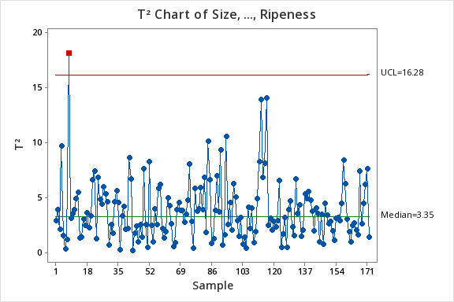
Correlated Variables: Hotelling Chart (T2)
1 point is out of control, otherwise limits are mostly good for a multivariate chart.
Shows a nice random, sort of cyclc pattern
In control
Plotted for subgroup size of 20

Slide 18
Conclusion
This was an attempt to analyse a random data set from the internet with a quality perspective
We attempted to identify factors affecting the quality of the apple from among the 6 variables
The dataset was pretty large for quality analysis, we applied the 80/20 rule to clean the data
We attempted to explain quality by the variable chart (Xbar-R) and the multivariate chart (T2)
Although some out of control points were identified however they had negligible effect since the dataset was large, few points wouldn’t matter
Overall, this analysis was a good study in the different methods of quality control

Slide 19
THANK YOU!
Hope you enjoyed and don’t have any questions

